Slide 1
Loan approval Analysis
Project PRESENTATION

Slide 2
Agenda
Introduction
Understanding the dataset
Hypothesis
EDA
Observation
Recommendation
Conclusion

Slide 3
project
introduction

Slide 4
Introduction
In this assessment, we will perform an Exploratory Data Analysis (EDA) on a dataset related to home loan approval. The dataset is sourced from Skill Circle and contains valuable information for analysis. The primary focus of this assessment is on data exploration and visualization.

Slide 5
What to expect ?
Gain familiarity with the dataset.
Perform data exploration and visualization.
Identify patterns, trends, and potential insights.
Generate meaningful visualizations to
Communicate your findings.

Slide 6
Understanding the dataset

Slide 7
Dataset description
Dataset Description:
Contains 12 attributes.
Captures essential aspects of loan approval data.
Attributes:
Loan_ID: Row identifier.
Gender – Male/Female applicants
Married – Marital status of the applicant.
Dependents – Number of dependents the applicant has.
Education – Whether the applicant is Graduate or Not.
Self-Employed – Whether the applicant is self-employed
Applicant Income – The income level of the loan applicant
Coapplicant Income – The income of any co-borrower
Loan Amount – The amount of loan requested by the applicant.

Slide 8
Dataset description
Loan Amount – The amount of loan requested by the applicant
Loan Amount Term – The duration for which the loan is sanctioned.
Credit History – Whether the applicant has a history of loan repayment.
Property Area – The type of area where the applicant resides (Urban, Semi-Urban, Rural).

Slide 9
Key steps to perform

Slide 10
Key steps to perform (Task 1 - Data Exploration)
Load the dataset into a Python environment (e.g., Jupyter Notebook).
Display the first few rows of the dataset to understand its structure.
Check for missing values and handle them if necessary.
Summarize basic statistics (mean, median, standard deviation, etc.) for the numeric columns.

Slide 11
Key steps to perform (Task 2 - Data Visualization )
2.1 Univariate Analysis - Explore the distribution of numeric columns using the following visualizations:
Histograms: Plot the frequency distribution of key numeric variables.
Box Plots: Identify potential outliers and visualize the spread of data.
Analyze categorical variables by creating the following plots:
Bar Charts: Visualize the frequency distribution of categorical variables. Pie Charts: Represent the composition of categorical variables

Slide 12
Key steps to perform (Task 2 - Data Visualization )
2.2 Bivariate Analysis :
Create scatter plots to explore relationships between pairs of numeric variables.
Use pair plots (scatter matrix) to visualize interactions between multiple numeric variables simultaneously.
Investigate the relationship between categorical and numeric variables using box plots or violin plots.

Slide 13
Key steps to perform (Task 2 - Data Visualization )
2.3 Multivariate Analysis :
Perform a correlation analysis to identify relationships between numeric variables.
Visualize correlations using a heatmap.
Create a stacked bar chart to show the distribution of categorical variables across multiple categories.

Slide 14
Hypothesis

Slide 15

Hypothesis 1
Self-employed applicants have a lower approval rate compared to salaried individuals.

Slide 16
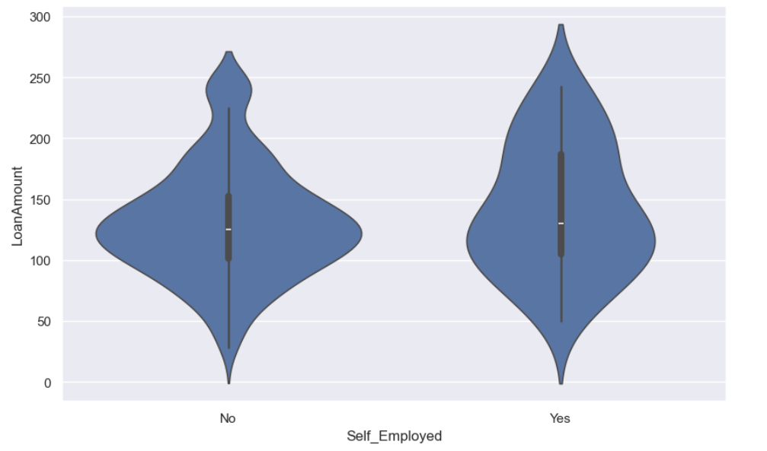
Justification of hypothesis 1
Violin plot between loan amount and self employed justifies the hypothesis.

Slide 17
Hypothesis 2
Applicants from rural areas are unlikely to get the loan approval in comparison to that of urban areas.

Slide 18
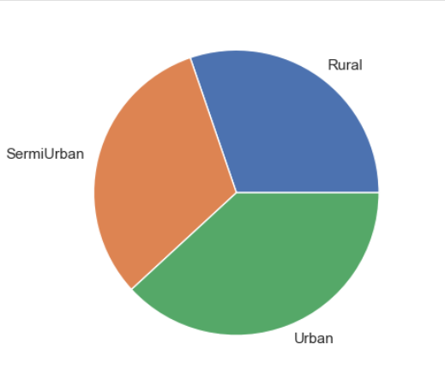
Justification of hypothesis 2
Pie chart of Property areas justifies the hypothesis.

Slide 19
Hypothesis 3
Higher loan amounts are associated with a lower approval rate and vice-versa.

Slide 20
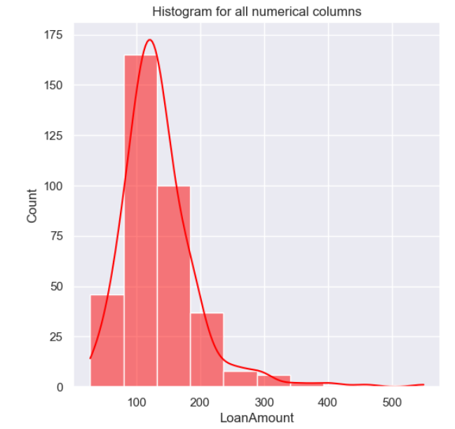
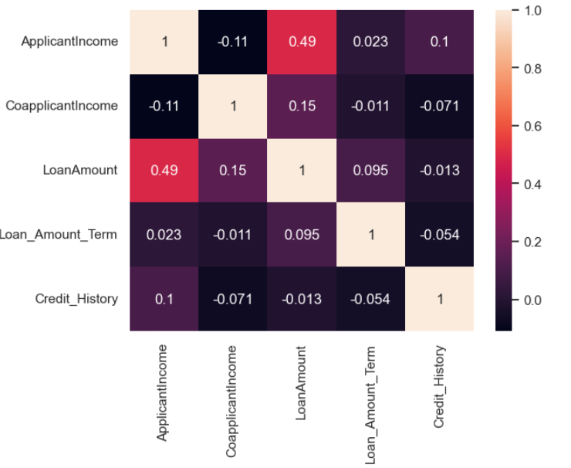
Justification of hypothesis 3
Presented heatmap shows the correlation is strong between loan amount and applicant income i.e., around 0.5. and hence justifies the hypothesis.

Slide 21
Exploratory Data Analysis

Slide 22
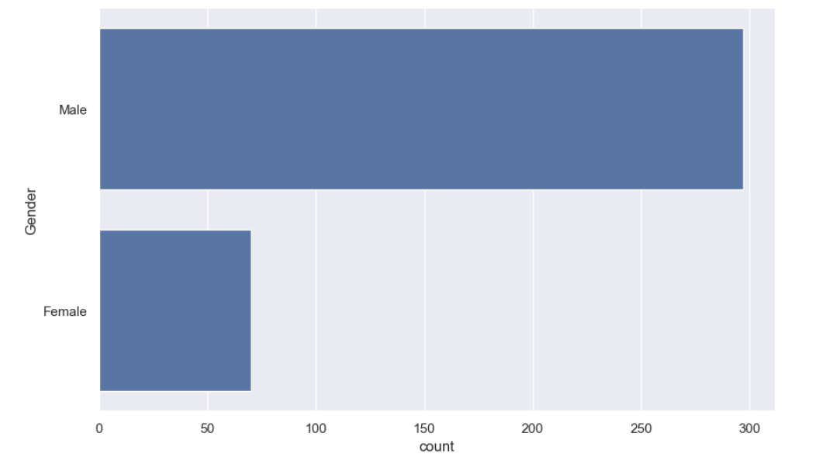
EDA - Graphics

Slide 23
Observations
1. Credit history is the most significant factor in loan approval.
Applicants with a good credit history have a much higher approval rate than those without.
2. Self-employed applicants have a lower approval rate.
A noticeable difference exists between salaried and self-employed applicants in loan sanctioning.
3. Loan amount and income levels impact approval chances.
Higher-income applicants tend to receive higher loan approvals, while larger loan amounts show a decreasing approval trend.
4. Loan amount and income levels impact approval chances.
This could be due to perceived financial stability.

Slide 24
Recommendation
Encourage applicants to maintain a strong credit history.
Banks should emphasize the importance of timely repayments to improve approval chances.
Develop flexible loan schemes for self-employed individuals.
Consider alternative credit scoring methods like transaction history and business performance metrics.
Set income-based loan eligibility limits.
Financial institutions can adjust loan approval policies to align with applicant income levels and risk management.
Improve loan processing strategies for high-loan applicants.
Offer additional verification steps or flexible payment terms for high-value loan
1. Encourage applicants to maintain a strong credit history.
Banks should emphasize the importance of timely repayments to improve approval chances.
2. Develop flexible loan schemes for self-employed individuals..
Consider alternative credit scoring methods like transaction history and business performance metric
3. Set income-based loan eligibility limits.
Financial institutions can adjust loan approval policies to align with applicant income levels and risk management.
4. Improve loan processing strategies for high-loan applicants.
Offer additional verification steps or flexible payment terms for high-value loan applicants.

Slide 25
conclusion
Credit history is the most crucial factor in determining loan approval.
Self-employed individuals face higher rejection rates compared to salaried applicants.
Higher loan amounts decrease the likelihood of approval.
Better financial awareness and alternative scoring mechanisms can improve approval rates and financial inclusion.

Slide 26
THANK YOU
By Shivam Gupta

